Slide 1



CLINIC2LAB
DIGITAL BONDING BETWEEN CLINIC AND LAB
www.clinic2lab.com

Slide 2

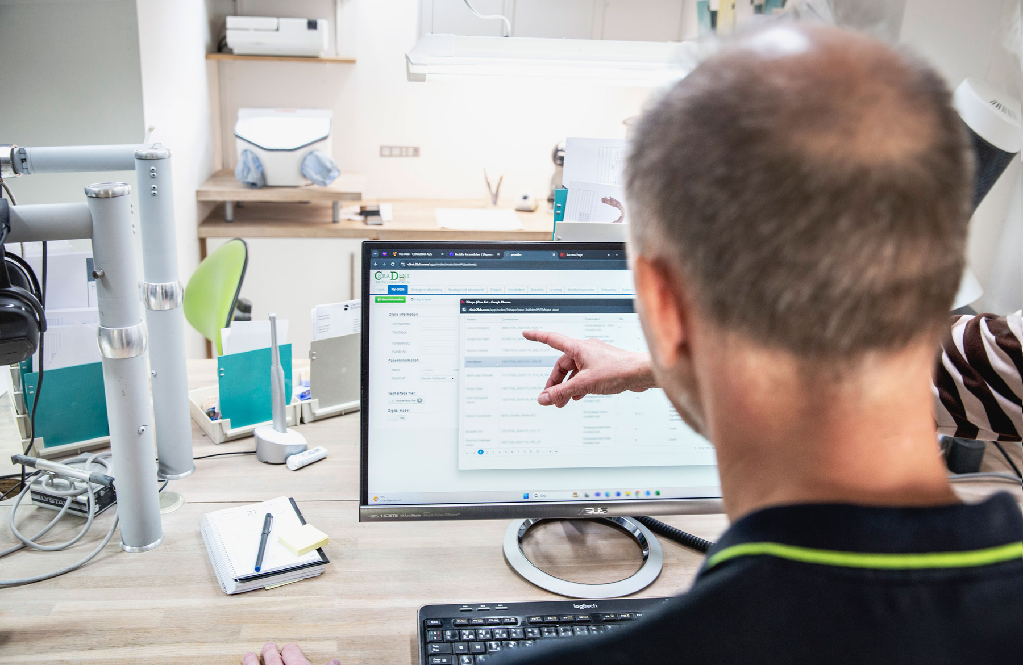

CLINIC2LAB
WHO ARE WE?
  Founded in 2019
  Based in Aarhus, Denmark
  Operational in Denmark, Norway, Sweden, Germany, China, Thailand
Michael Jakobsen
CEO
Laila Rehmeier
CCO

Slide 3
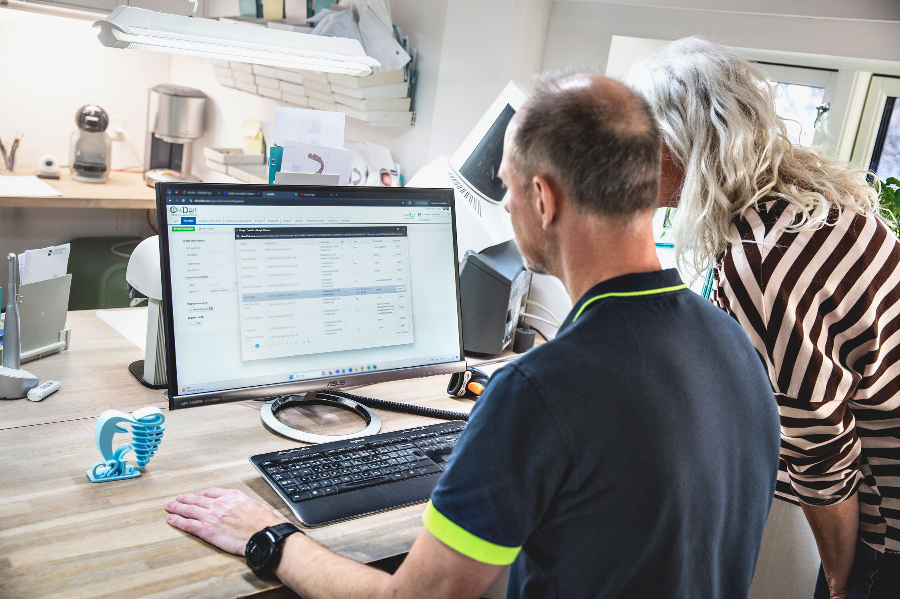

CLINIC2LAB
Made specifically by dental professionals for easy and secure collaboration between dental clinics and dental laboratories.
www.clinic2lab.com

Slide 4
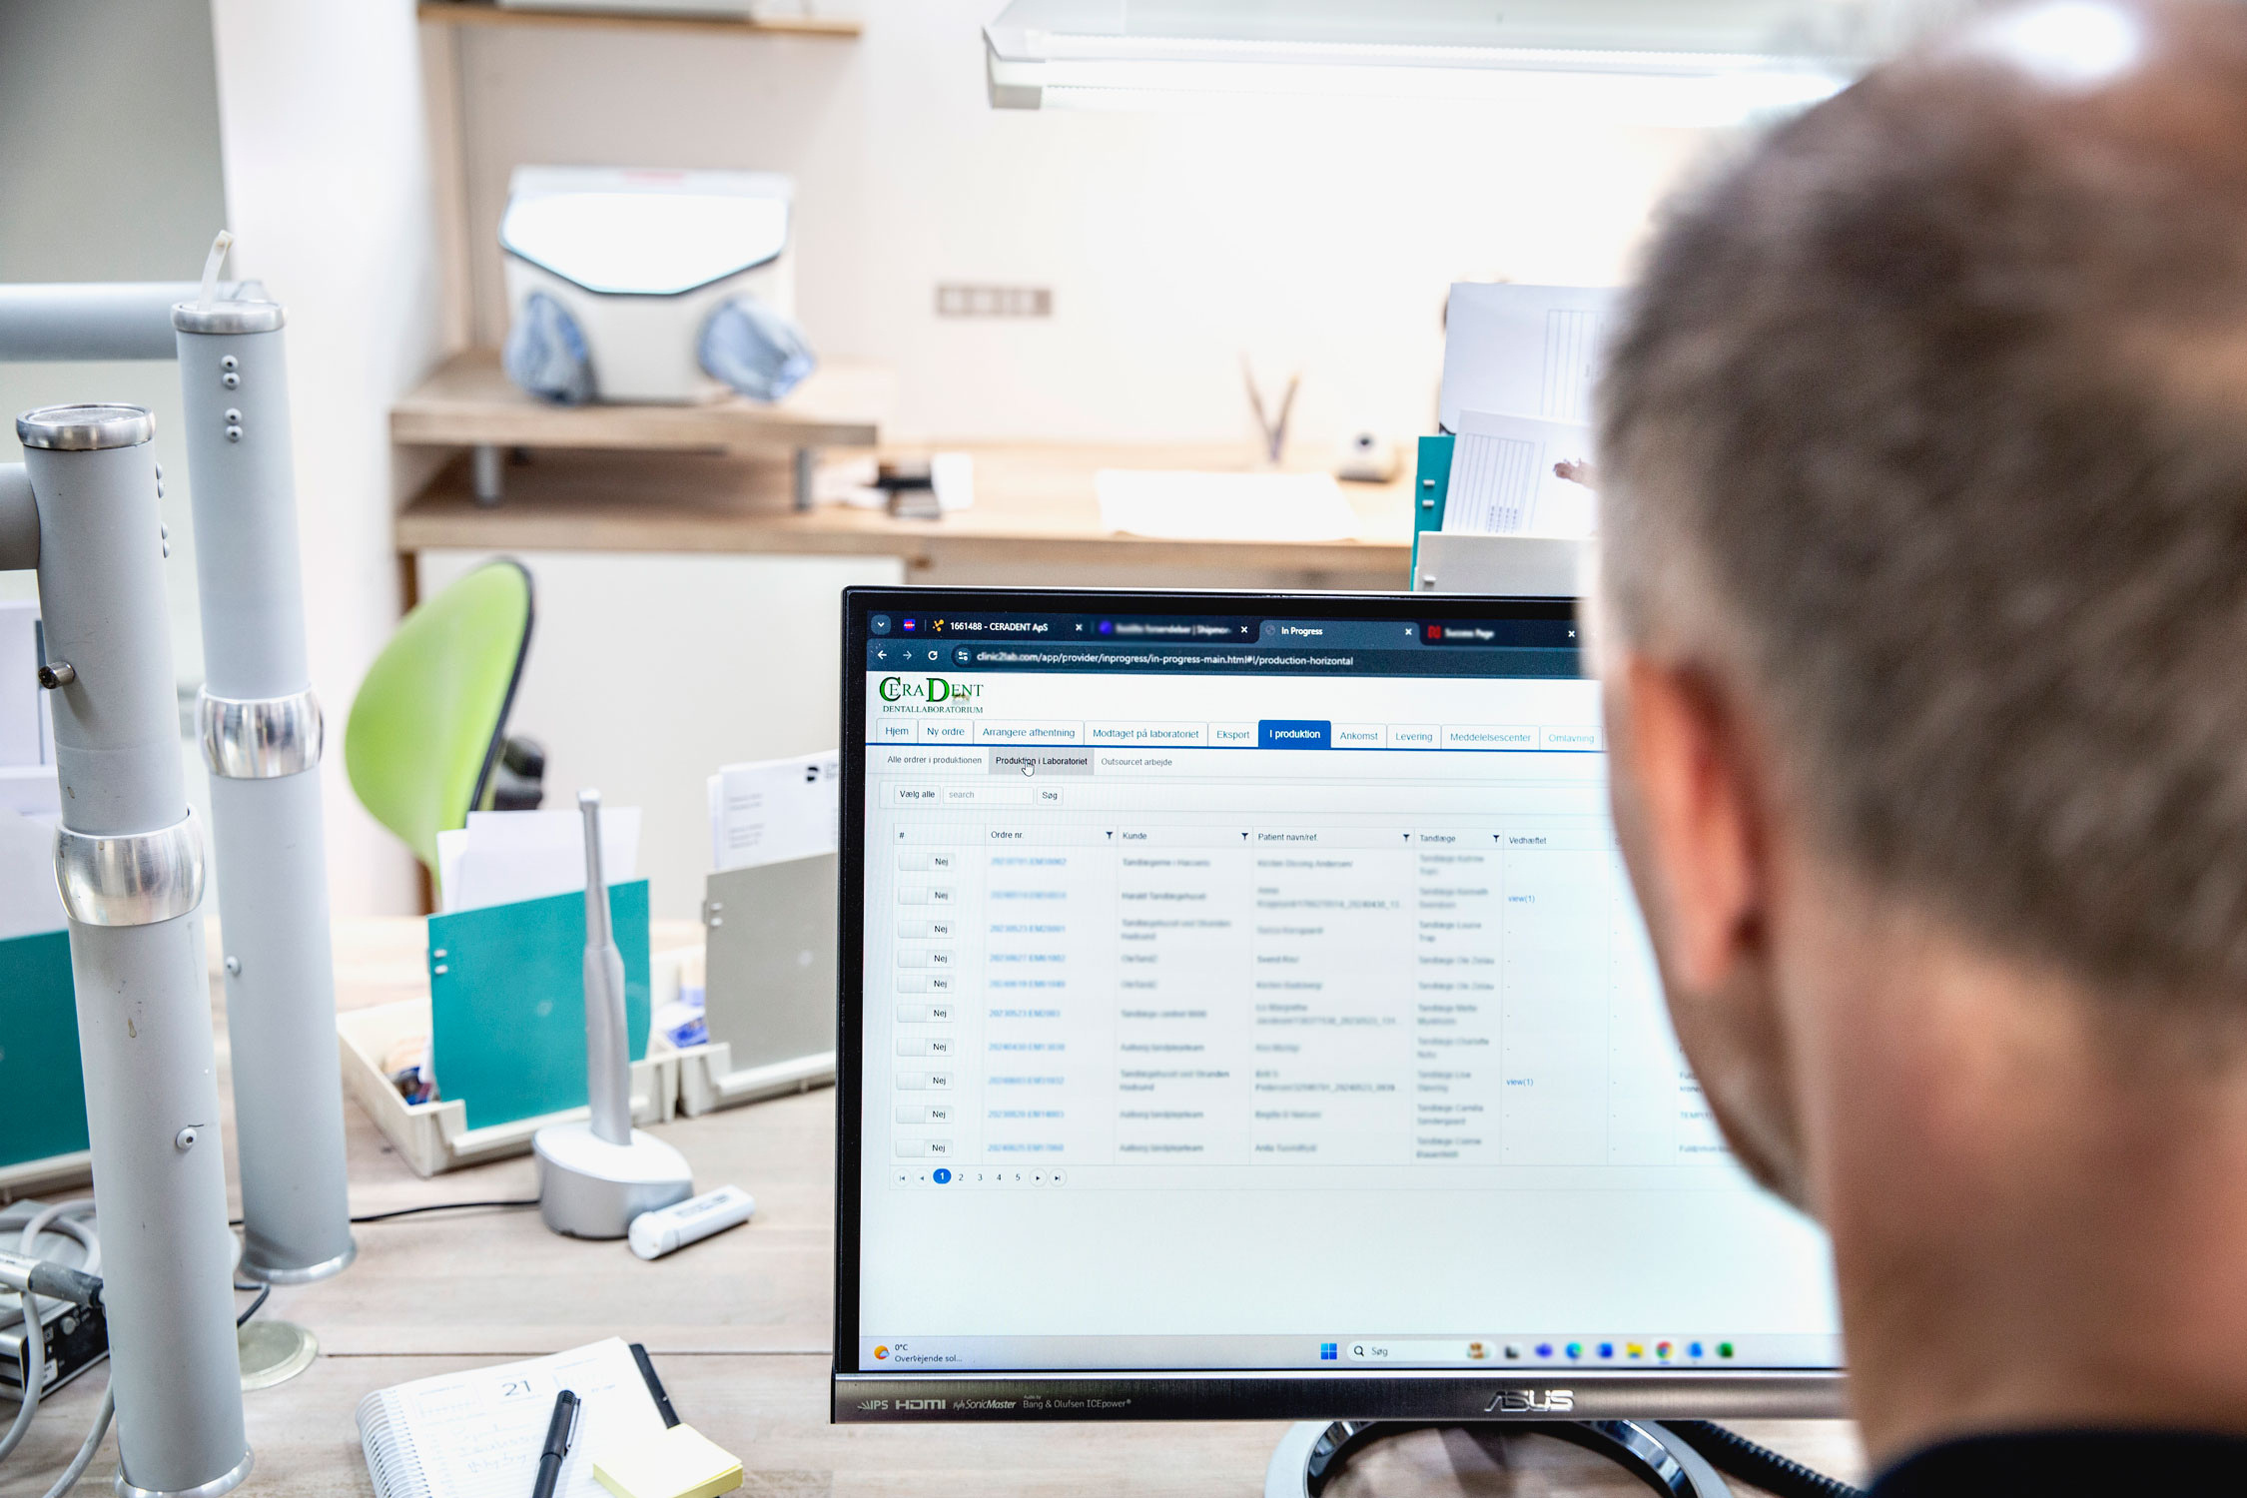
ABOUT
CLINIC2LAB
  Webbased system for effortless communication between dental clinics and labs
  Ongoing development
  ONE platform for administration, documentation, logistics and production processes
www.clinic2lab.com

Slide 5
#1 DIGITAL ORDER FORM
#2 ORDER CREATION
Efficiently minimizes manual work in a sustainable way.
Create the order directly in the system – it’s easy and straightforward.
YOUR
BENEFITS
#3 TRACK AND TRACE
#4 COMMUNICATION
Follow your order and be notified when the order is on its way.
Easy exchange of messages between the clinic and the laboratory.
CLINIC2LAB
#5 MDR AND SECURITY
#6 INTEGRATIONS
The system meets current authority (MDR) and GDPR requirements.
Ensures an efficient and smooth invoicing and bookkeeping process.
www.clinic2lab.com

Slide 6

MDR
COMPLIANCE
Requirements of the MDR regulations must be complied with. Clinic2Lab helps you with the documentation process.

Slide 7
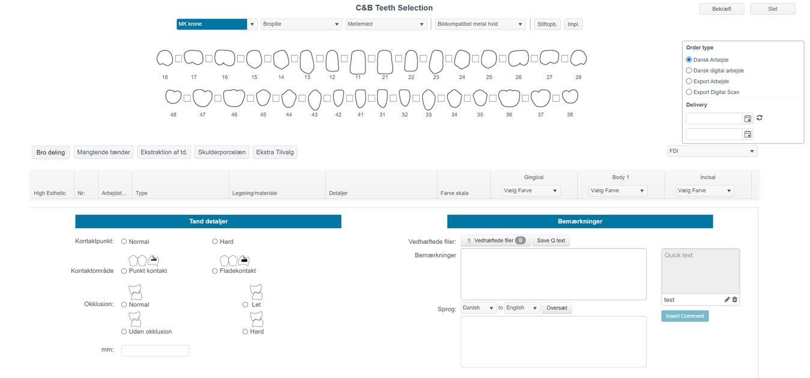

PRODUCT
.
DEMONSTRATION
www.clinic2lab.com

Slide 8
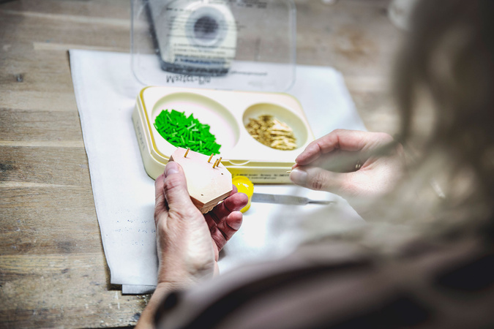
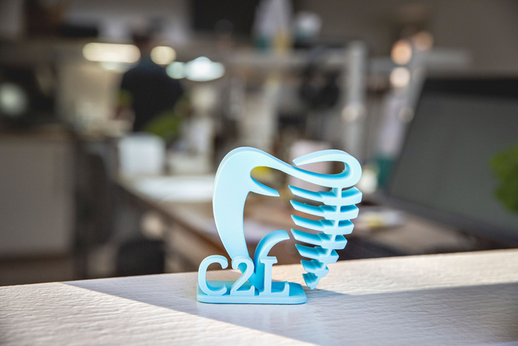
EASY AND SAFE
CLINIC2LAB
  Optimise your daily work processes and save time with Clinic2Lab!
  The system will help you comply with MDR documentation requirements
  Increased quality control
  Follow your orders - and allow your customers to do the same
www.clinic2lab.com

Slide 9
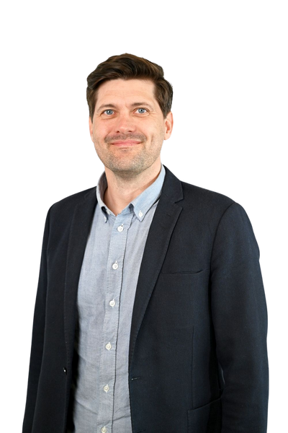
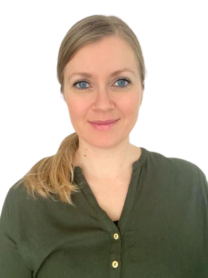
CONTACT
Want to know more about Clinic2Lab and the opportunities for you and your organization? Reach out to our team for additional information.
Michael M. Jakobsen
CEO, Clinic2Lab
mmj@clinic2lab.com
+45 20 88 13 95
Laila Rehmeier
CCO, Clinic2Lab
lar@clinic2lab.com
+45 xx xx xx xx
Book Now
Schedule

Slide 10
THANK YOU FOR YOUR TIME
www.clinic2lab.com

